Slide 1

Types of Report
Lecture 5

Slide 2
Report Writing Style
Informal Writing Style |  | Formal Writing Style
Use | Short, routine reports Reports for familiar audiences Noncontroversial reports Most reports to company insiders | Theses Research studies Controversial or complex reports (especially to outsiders)

Slide 3
Informal Writing Style |  | Formal Writing Style
Effect | Feeling of warmth Increased personal involvement Enhanced closeness | Impression of objectivity, accuracy Projection of professionalism, fairness Distance created between writer and reader

Slide 4
Informal Writing Style |  | Formal Writing Style
Characteristics | Use of first-person pronouns (I, we, me, my, us, our) Use of contractions (can’t, don’t) Emphasis on active-voice verbs (I conducted the study) Shorter sentences; familiar words Occasional use of humor, metaphors Occasional use of colorful speech Acceptance of author’s opinions and ideas | Absence of first-person pronouns; use of third person (the researcher, the writer); increasingly, however, the informal style is acceptable Absence of contractions (cannot, do not) Use of passive-voice verbs (the study was conducted) Complex sentences; long words Absence of humor and figures of speech Little use of colorful adjectives and verbs Elimination of “editorializing” (author’s opinions, perceptions)

Slide 5
Unique Aspects of Report
Length and Scope | Short | 1-5 pages length. Limited Scope. Limited Timeframe>> finical impact >>personal >>impact on the company
 | Long | More than 5 pages. Large Scope Long timeframe>> significant amounts of money, research, many employees, and a momentous impact on the company
Formality (Tone) | Informal | Most short reports are informal, routine messages
 | Formal | Formal reports are usually long and contain standardized components, such as a title page, Table of Content, list of illustrations, abstract, appendices, and work cited/ references

Slide 6
Unique Aspects of Report
Audience | Internal (High Tech & Low Tech) | Colleagues, supervisors, co workers
 | External (Multiple audience Level) | Vendors, clients, customers and companies
 | Internal and External | Both internal and External
Purpose | Informational | Focus of Factual Data
 | Analytical | Provide information but analyze the causes behind occurrences
 | Persuasive | Persuasion to justify recommended fellow-up action.

Slide 7
Major Types of Report
Informal Report
Informal report is a shorter, less structured document used for internal communication, often written in a conversational style and with fewer formalities.
Formal Report
Formal report is a structured, detailed document with a predefined format, typically used for significant decisions and including sections
Executive summary
Analysis
Recommendations

Slide 8
Informal Report
A report which is short in length and used to deliver information within an organization is known as Informal report.
It deals with the analysis of everyday problems and issues along with some suggestions and recommendations.

Slide 9
Types of informal report
Incident Report
Investigative Report
Progress Report
Meeting Minutes
Feasibility/ Recommendation
Trip Report
Lab Report
Research Report
Proposal

Slide 10
Incident Report
An incident report documents an unexpected problem that has occurred. This could be an automobile accident, equipment malfunction, fire, robbery, injury, or even problem with employee behavior.
In this report, you will document what happened.
If a problem occurs within your work environment that requires analysis (fact finding, review, study, etc.) and suggested solutions.

Slide 11
Format of an Incident Report
Introduction
Purpose (when and where the incident occurred. What motivated your visit to the scene of the problem?)
Personal ( who was involved, and what role do you play in the report? Why are you involved in the activity? Are you a maintenance employee responsible for repairing the malfunctioning equipment?
Discussion (body, findings, agenda, work accomplished)
Conclusion ( Explain what caused the problem)
Recommendations (Related what could be done in the future to avoid similar problem)

Slide 12
Investigative Report
Investigative Report asks you to examine the causes behind an incident. The report does not just document the incident. It focuses more on why the event occurred.
You are working in a college’s technology department. Primarily, your job is to help faculty members with their technology application. The college requires that all student grades be kept on a newly installed, campus wide database and then submitted electronically when the semester ends. For some reason, faculty cannot access their students’ records for grading inputting. You must investigate the causes behind this technology glitch and solve the problems– now! The semester grades are due within 24 hours.

Slide 13
Format of Investigative Report
Introduction (Overview, Background)
Purpose ( Document the date of incident. What are incident are you reporting on and what do you hope to achieve in this investigation)
Location
Personal ( who is involved in the incident?)
Authorization ( who recommended or suggested that you investigate the problem?)
Discussion (body, findings, agenda) >> 4w+1H >> contacts >> Difficulties encountered
Conclusion
Recommendations

Slide 14
Trip Report
A trip report allows you to report on job-related travel. When you leave your work site and travel for job-related purposes, your supervisors not only require that you document your expenses and time while off site, but that also want to be kept us to date on your work activities. For example, a trip to a conference on emerging technologies

Slide 15
Format of a Trip Report
Introduction (Overview, Background)
Purpose ( Document the date of trip, your destination)
Personal ( with whom did your travel )
Authorization ( who recommended or suggested to leave your workplace)
Discussion (body, findings, agenda)>> what did you learn. Whom did you meet, sales,
Conclusion
Recommendations >> your suggestions

Slide 16

Progress Report
A progress report is generally used to present the status of an ongoing project and the attained progress.
This category is used in different forms of scientific projects and is generally drafted for providing all the details to a funding agency supporting the project.

Slide 17
Sales Activity Report
Showcases the performance of each sales activity that occurs within a company.
Sales figures
Conversion rates
Lead generation
customer acquisition costs

Slide 18
Lab Report
A lab report lets you document the status of and findings from a Laboratory experiments, procedure, or study.
Professionals rank the ability to communicate as highly as they do their technical skills.
The knowledge acquired from lab activities must be communicate to colleagues and supervisors so they can benefit from your discoveries.
You write a lab report after you have performed the lab to share your findings.

Slide 19
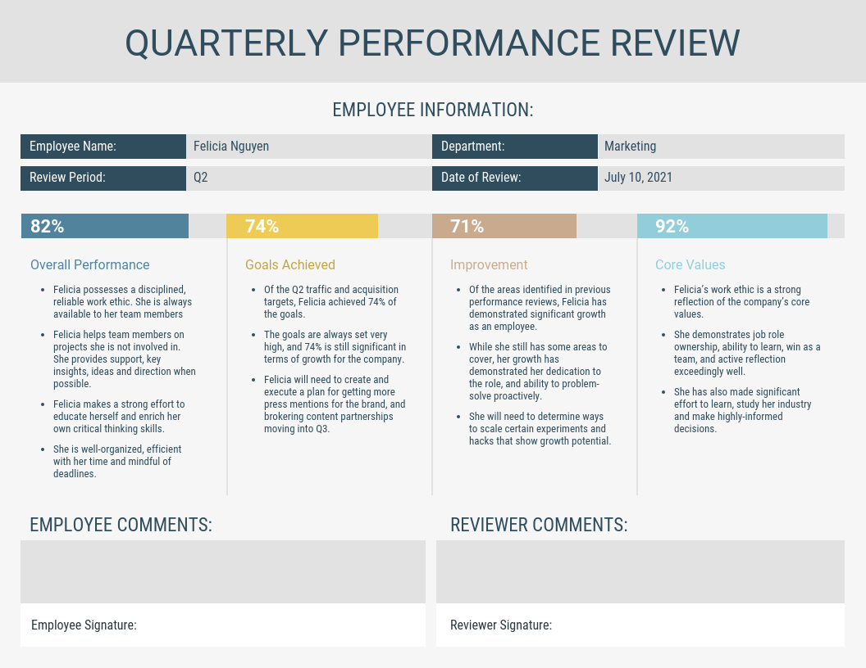
Personnel Evaluation Report
Assesses an employee's performance. It's used to monitor employee tasks, provide feedback, and identify areas for improvement.
Employee strengths
Performance goals
Feedback on communication
Collaboration with colleagues
Overall rating
Recommendations for future development

Slide 20
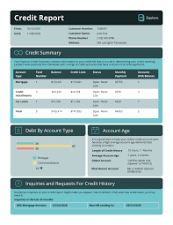
Credit Report
Credit reports are usually prepared by a Credit Bureau to provide details of an individual’s or an organization’s credit history. Such reports help in maintaining a written record of all the transfers of money in the form of loans.
Personal information
Account information
Payment history
Public records
Credit inquiries

Slide 21
Meeting of Minutes
Meeting minutes document the results of a meeting— what was discussed, proposed, voted on, and planned for future meetings.
In meeting minutes, you record who attended the meeting, when it began, when it ended, where it took place.
You report on the topics discussed, decisions, and plans for future.

Slide 22
Research Report
A research report can be informal if it is short, brief, and follows a simple structure, such as a memo or email, to communicate findings within an organization.
While still presenting facts and research, an informal research report focuses on direct, concise communication of information for internal audiences, using minimal, if any, formal sections, and prioritizing a clear, straightforward presentation of the research.

Slide 23
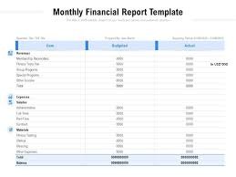
Financial Report
Type of report which is used to provide a detailed description of all the financial activities of some person, business, market or an organization in the form of a statement is known as Financial Report.
The balance sheet
Income statement
Cash flow statement

Slide 24
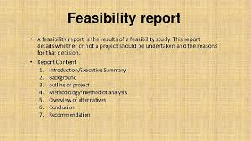
Feasibility Report
Such types of report are used to provide a description of the assessment carried out to evaluate the recommended solutions and recommendations with respect to a problem or analyzed subject matter.

Slide 25
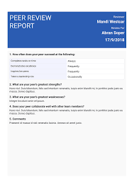
Review Report
Review Reports are used to present a review on the studied literature or subject matter. Such reports are used with an intent to make a detailed content more specific for the readers of your draft so that they may not have to scan the details of a text.
The audience for this is high-tech but may be modified to be read by the low-tech audience.

Slide 26
Formal Report
The second major type of a report which is long, detailed and complex is called a formal report.
These are separately classified as these reports cover a written account of a major project
Provide a review or results of a study based on the data collected and its interpretation.

Slide 27
Types of Formal Report
Informational Report
Recommendation Report
Analytical Report

Slide 28
Informational Report
As the name implies, these reports focus on the provision of specific information. In such reports, specific information refers to the status or updates regarding an ongoing project.
If some mechanism is being applied to carry out a survey or an experiment, an information report is used to provide details about the extent to which this mechanism is getting successful in achieving the set goals and objectives.
In other words, the focus of this report remains on the provision of results in general or the outcomes.

Slide 29
Informational Report
Key point
Present factual information and data without personal opinions or bias
Focus on facts
Clear structure
Neutral tone

Slide 30
Recommendation Report
This report is used to advocate a particular course of action based on the study of suggestions and recommendations.
Such a report should include discussion on results either supporting or negating a proposed suggestion.

Slide 31
Key point
Present a well-supported suggestion or course of action based on analyzed data
Clearly outlines a problem
Revaluates different potential solutions
Recommends the most viable option to address the issue

Slide 32
Analytical Report
The type of report which is used to provide a detailed analysis of the results and outcomes to draw a conclusion is known as Analytical Report.
This type is used to focus on the interpretation of the incident, event or subject matter being investigated (analysis of what happened)

Slide 33
Key point
Present data-driven insights and conclusions based on analysis.
Allowing decision-makers to understand a situation.
Identify problems, and make informed choices by providing evidence-based interpretations and recommendations, rather than just stating facts.

Slide 34
Some Additional Forms of Report
Narrative Report
Specialized Report
Accident Report
Non-chronological Report

Slide 35
Narrative Report
A narrative report is a report which has information in a logical sequence of events, usually in a chronology.
Case Studies can be considered as an example of these reports

Slide 36
Non-chronological Report
A report which provides a discussion of various aspects of a subject matter irrespective of the order in which the information is being provided.

Slide 37
Specialized Report
To accommodate the need for a report to provide a summary of all the other reports related to a single subject matter, specialized reports are made.
This is different from a review report; a review report will discuss a particular subject matter whereas a specialized report may consider reports related to allied subject matter, as well.

Slide 38
Accident Report
A report which provides all the documentation and investigation regarding an accident.

Slide 39
Summary
Types of Report
Informal and formal Report
Types of informal Report
Types of formal Report
Other types of Report

